Slide 1

Telecom Customer Churn Prediction
By: Dan Zhai, Liyuan Sun, Sangram Kapre, Shuai Li

Slide 2
Introduction
Purpose:
Predict behavior to retain customers. Analyze the customer specific data to build a model for churn prediction.
Four parts:
Data Exploration
Feature Preprocessing
Model Training
Models Comparison

Slide 3
Part 1: Data Exploration
Row data:
1 target column: churn or not
20 feature matrix columns: 17 categorical columns
3 numerical columns
Rows: | 7043 | customer
Columns: | 21 | attribute

Slide 4
Demographic information:
CustomerID
Gender: F/M
Senior Citizen
Partner: Y/N
Dependents: Y/N
Tenure
Services signed up:
Phone Service: Y/N
Multiple Lines: Y/N/No phone service
Internet Service: DSL/Fiber optic/No
Online Security: Y/N/No internet service
Online Backup: Y/N/No internet service
Device Protection: Y/N/No internet service
Tech Support: Y/N/No internet service
Streaming TV: Y/N/No internet service
Streaming Movies: Y/N/No internet service
Customer account information:
Contract: Month-to-month/One year/Two year
Paperless Billing: Y/N
Payment Method: Electronic check/Mailed check/Bank transfer/Credit card
Monthly Charges
Total Charges

Slide 5
Part 2: Feature Preprocessing
Senior Citizen: Numerical Categorical
Total Charges: Categorical Numerical, and drop 0.16 % (11 rows) missing data
Online Security, Online Backup, Device Protection, Tech Support, Streaming TV, Streaming Movies: No internet service No
Binary features: [yes, no] [1, 0]
Make dummy variables for multi level categorical features

Slide 6
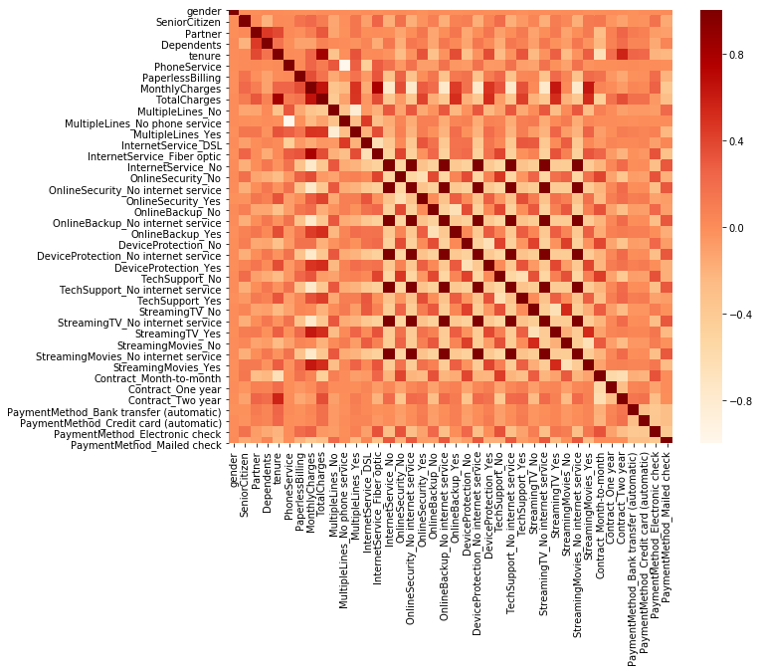
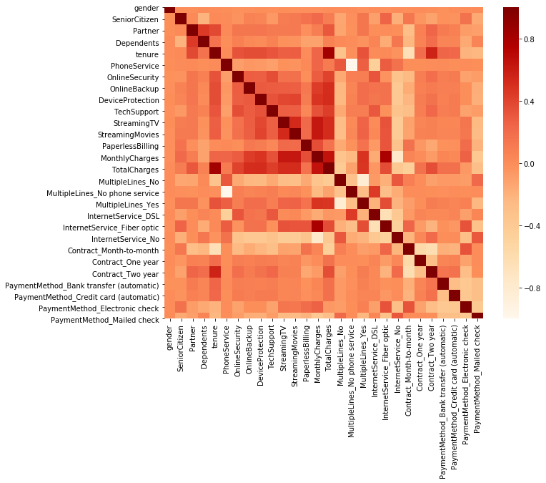
Correlation matrix

Slide 7
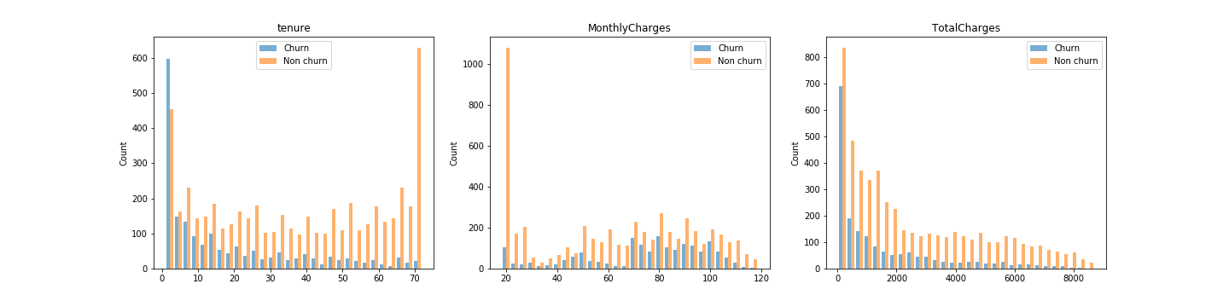
Numerical features plots

Slide 8
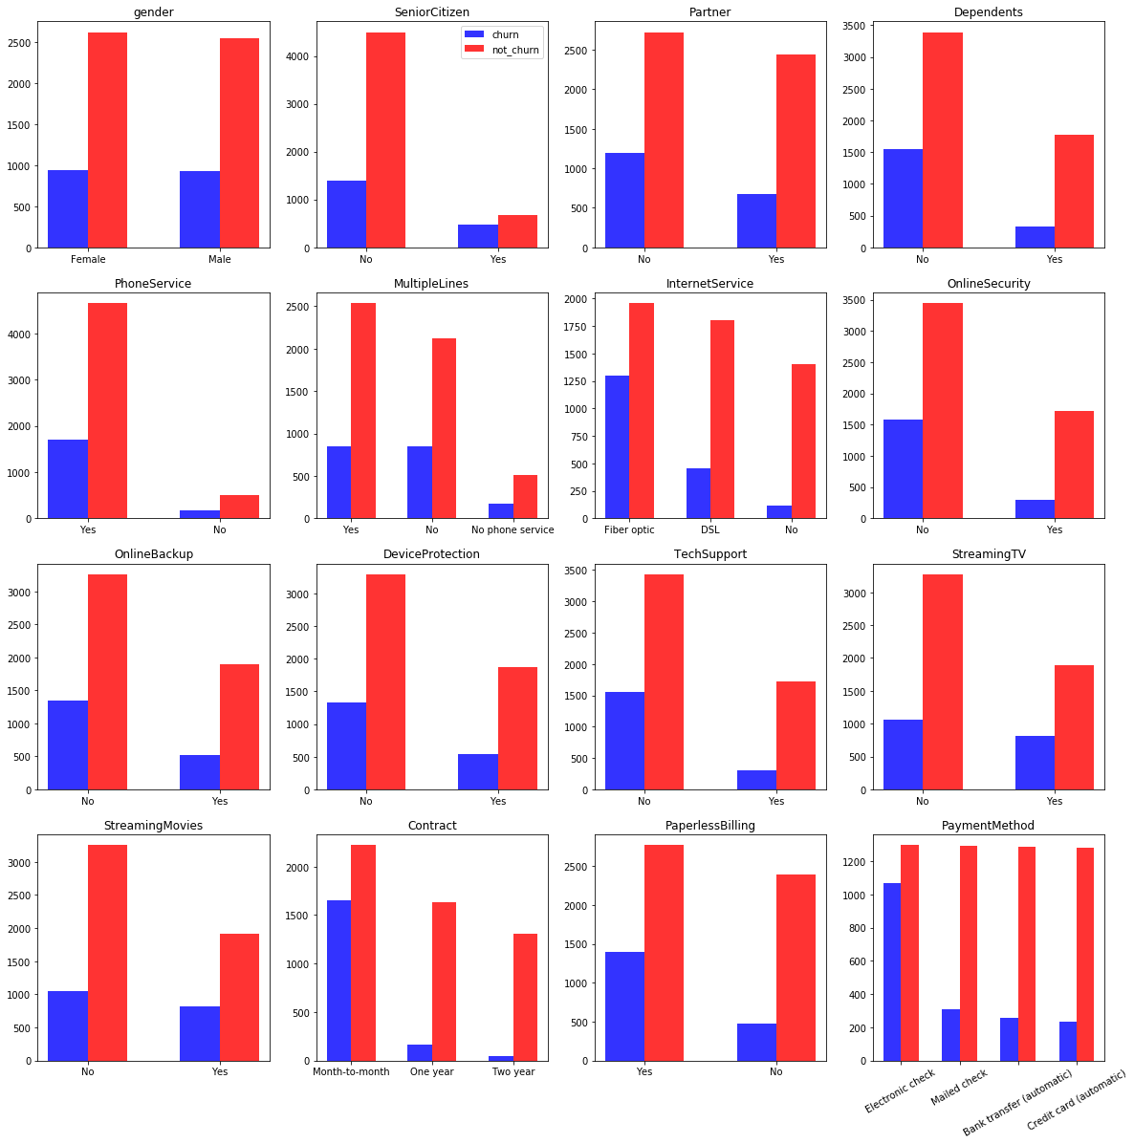
Categorical features
plots

Slide 9
Part 3: Model Training
Split Dataset:
Training data has 5625 observation with 28 features (80%)
Testing data has 1407 observation with 28 features (20%)
Model Training and Evaluation:
Logistic Regression
K-Nearest Neighbor (KNN)
Random Forest
Support Vector Machine (SVM)
Neural Network
Ensemble Model

Slide 10
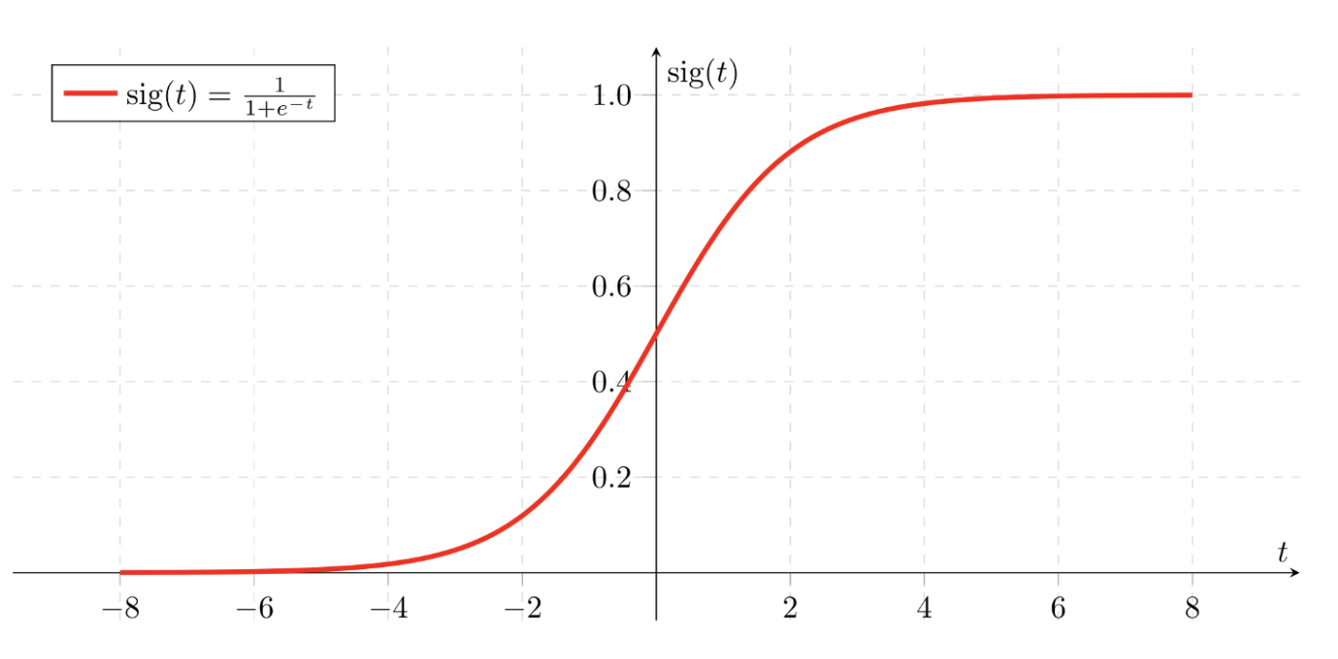
Logistic Regression
Machine Learning algorithms for two-class classification.
Hyperparameters: penalty, C
AUC on Test Dataset = 0.85
Accuracy = 0.81

Slide 11
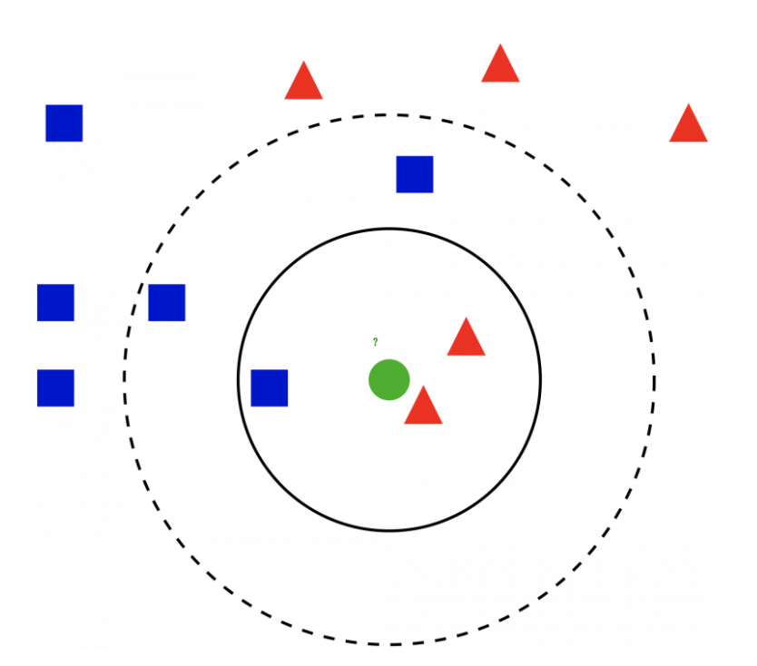
K-Nearest Neighbor
Classifies new cases based on a similarity measure (e.g., distance functions)
Hyperparameters: n_neighbor, weights, metric
AUC on Test Dataset = 0.83
Accuracy = 0.78

Slide 12
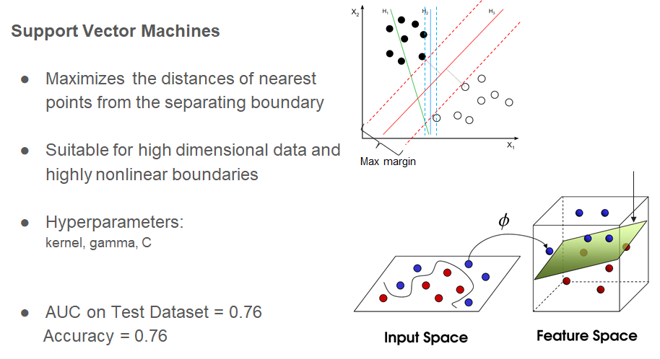
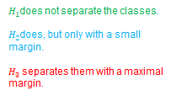

Slide 13
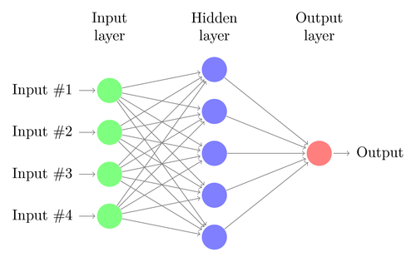
Neural Network Classifier
Multilayer perceptron based classifier
Hyperparameters:
max_iter, activation, hidden_layer_size
AUC on Test Dataset = 0.85
Accuracy = 0.80

Slide 14

Random Forest
Ensemble of multiple decision trees
Hyperparameters:
n_estimators, max_depth,
max_features, bootstrap
AUC on Test Dataset = 0.86
Accuracy = 0.80

Slide 15
Ensemble Model: VotingClassifier
Hopefully, each individual model captures different patterns in the data
Combining all models’ predictions may improve the overall performance
Predictions from a particular model gets a weight proportional to that model’s performance
VotingClassifier trains the best model and provides the weighted average of the probabilities where weights are provided by us
Performs better than all individual models in terms of AUC

Slide 16
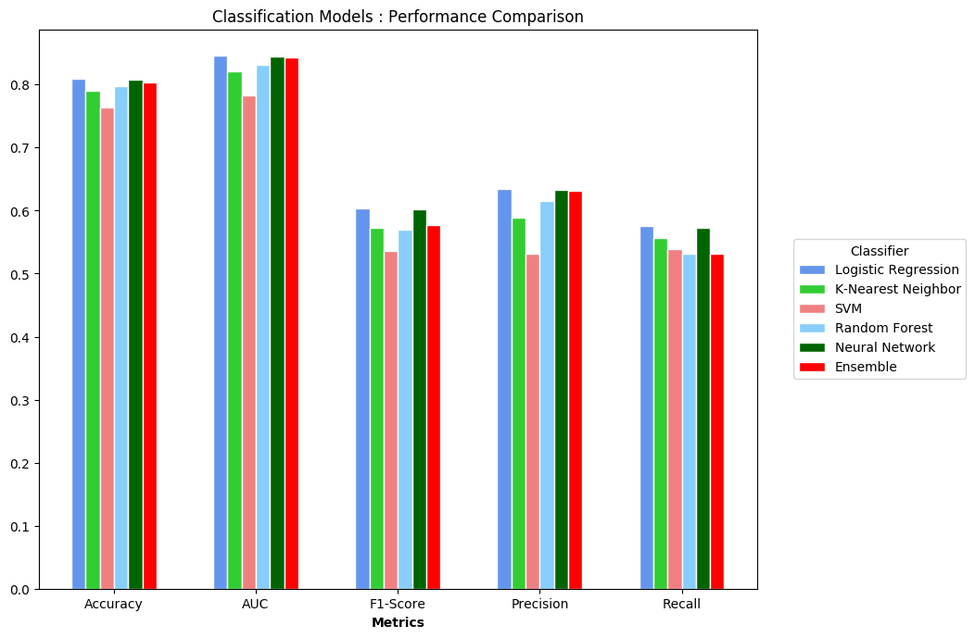
Part 4: Models Comparison

Slide 17
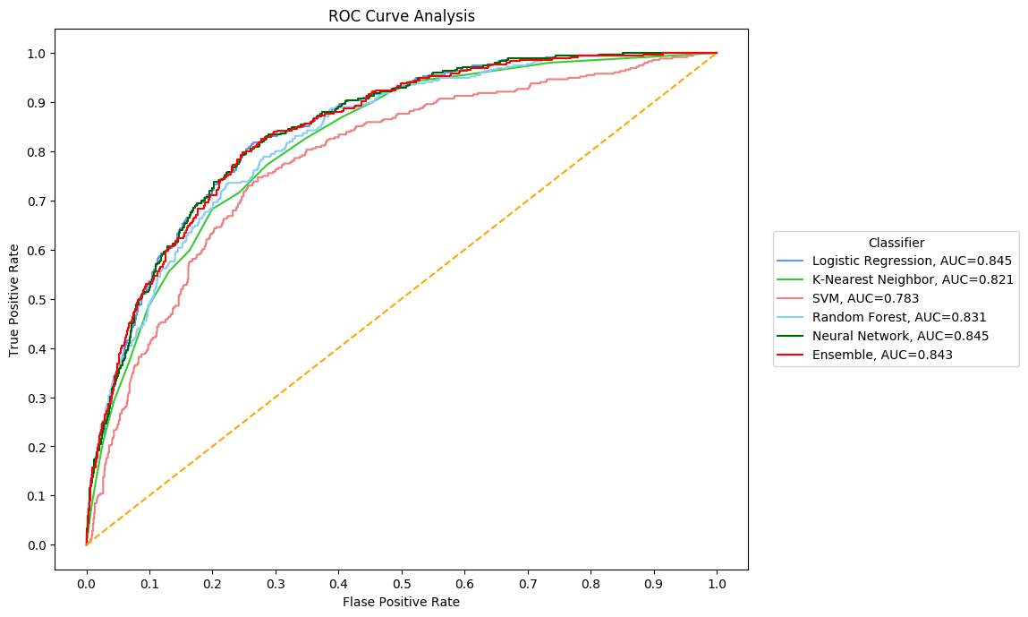
ROC Curve Comparison

Slide 18
Conclusion
For this data, SVM did not perform as well as other models
Ensemble model performed almost as good or better than individual models
Tuning the model for one particular metric may degrade the model performance on other metrics
Future work: feature selection, tuning on other metrics, advanced ensemble techniques

